Slide 1
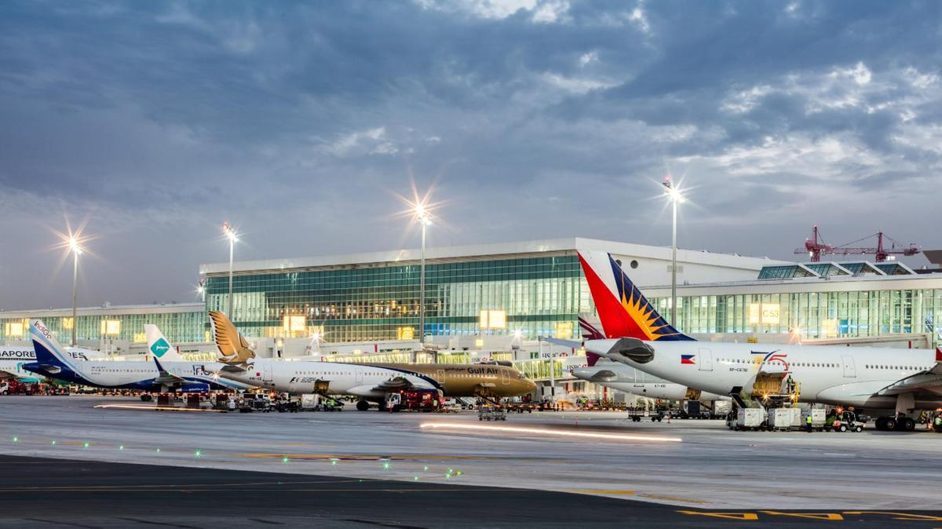
Predicting Upcoming Flight Delays
Shalini Jain
DATA 606 - Delivery 4
Notes:
Hey guys i’m Shalini, this is my DATA 606 delivery 4 presentation. Just as a reminder, I am working on predicting upcoming flight delays.

Slide 2
Project Overview
Predict upcoming flight delays based on previous delays
Help to prevent future delays
Help consumers know which airlines/airports to use and/or avoid

Slide 3
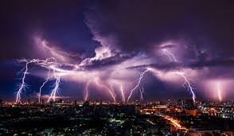
Why I Chose Weather Induced Delays
18.56% of flight delays were weather induced
Interesting to find datasets related to weather
Historical weather data

Slide 4

Delivery 4 Topics
Project Recap and Updates
Model Construction
Results
Setbacks
Next Steps
Notes:
Project recap of what i’ve been working on/ and updates

Slide 5

Using ML to predict flight delays
Focused on Multiple Linear Regression
Looking at weather related flight delays
Notes:
Mostly did multiple linear regression with different features. Tried random forest but didn’t go well. I didn’t think Naive bayes would be helpful.

Slide 6
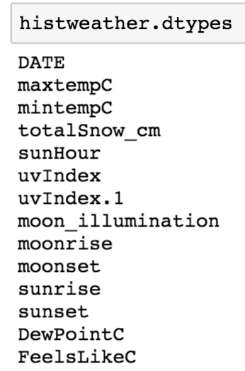
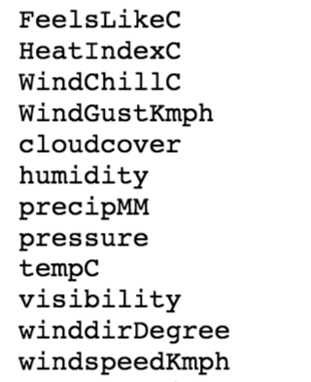
World Weather Online API
Notes:
total snow, windgust, cloudgover, windspeed

Slide 7
Exploratory Data Analysis
Dropped rows which stated that flights were cancelled
Dropped 89,884 rows
Dropped Reason of cancellation
Dropped columns with type of flight delays (except for weather_delays)
Notes:
Luckily Already in pretty good shape before i started.. Some of the Dropped Columns oringially.

Slide 8
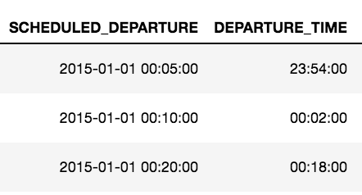
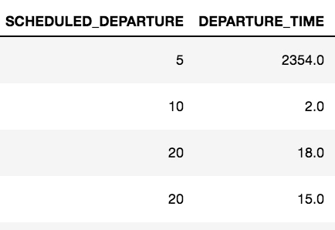
Exploratory Data Analysis
Notes:
Showing transformation i did on the date/times.

Slide 9
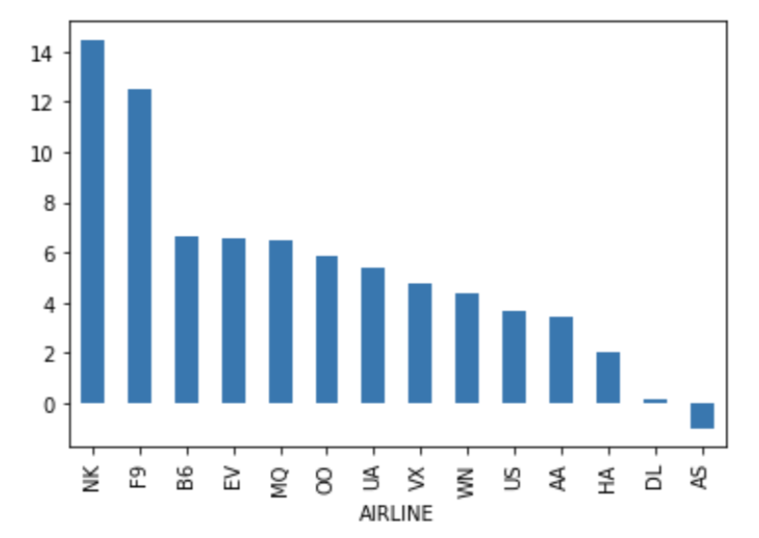
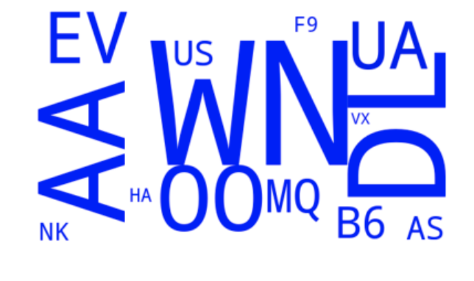
Exploratory Data Analysis
Notes:
Airlines:
EV - Atlantic Southeast Airlines
WN - SouthWest
DL - Delta Airlines
OO - Skywest
B6 - Jetblue
Nk - Spirit
#average arrival_delays by airline

Slide 10
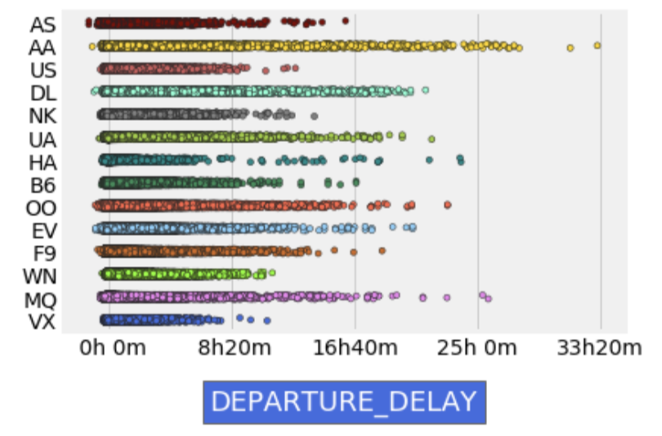
Exploratory Data Analysis
Notes:
Departure delays based on airlines.
American airlines AA has a lot of delays. Virging airlines. VX doesnt….

Slide 11
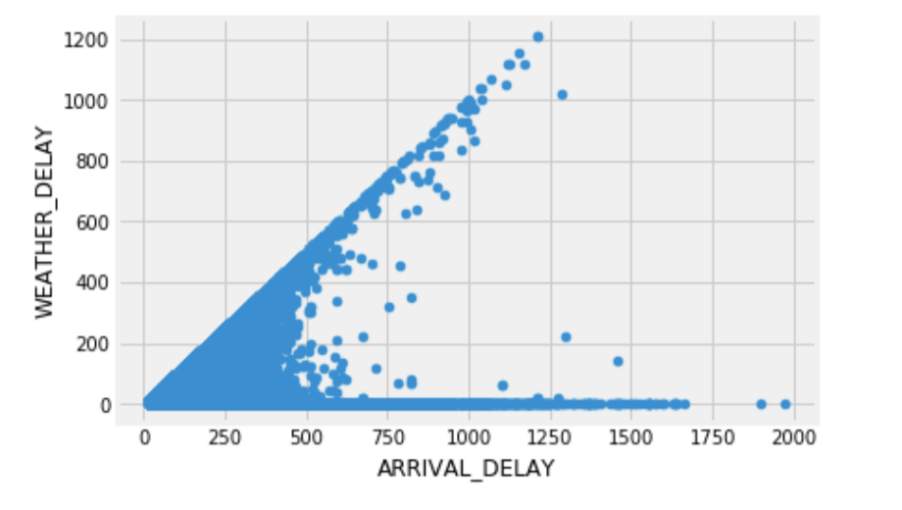
Exploratory Data Analysis
Notes:
Looking at correlation between arrival delay and weather delay

Slide 12
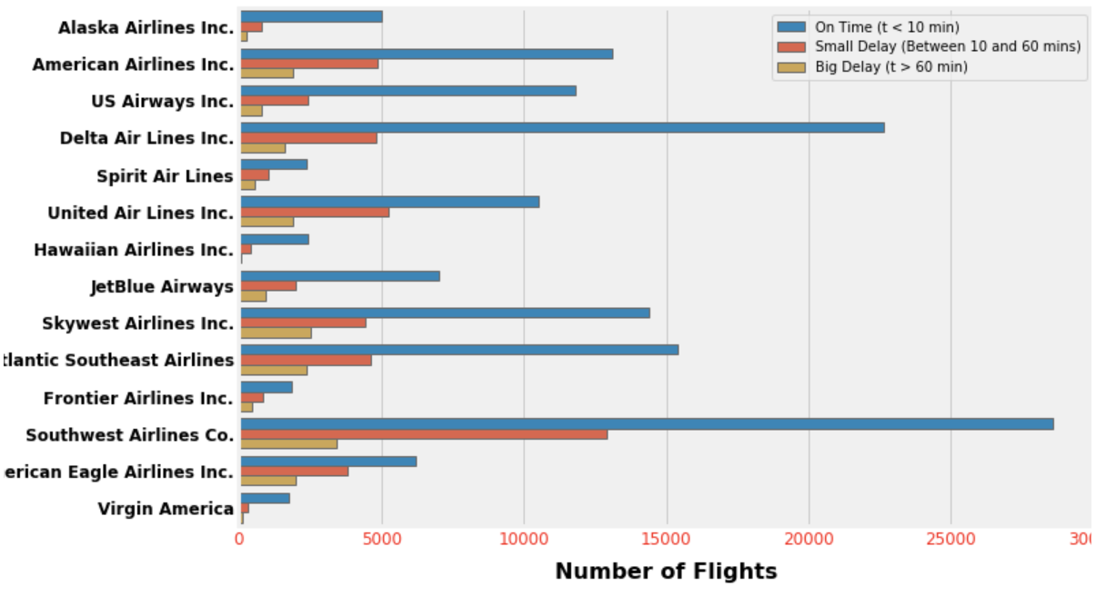
Exploratory Data Analysis
Notes:
Number of flights to get a better idea of each airline and the number of flights that have been delayed.
South West (NW)

Slide 13
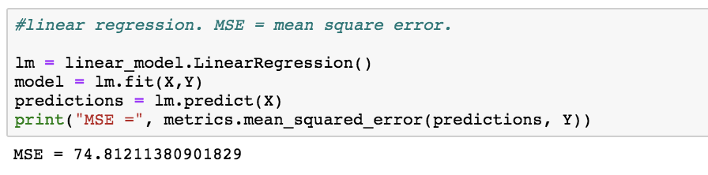
First Model Construction
Notes:
-Working on Linear and Polynomial Regression
-departure minutes
-Will be using other ML algorithms on my data as well
-Want to compare the accuracy of the models
-better explain this model!!!!!

Slide 14

Multiple Linear Regression
Dependent variable is always departure delay.
Notes:
After receving feedback from my peers and the professor, I decided to do a multiple linear regression. Instead of doing multiple ML algorithms, i decided to play around with the inputted features for mulitple linear regression.one thing to note is that throughout my project, i used departure delay as my dependent variable because that is what i wanted to predict.

Slide 15
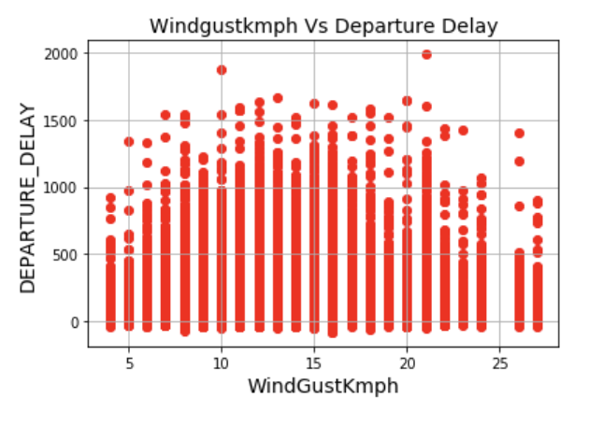
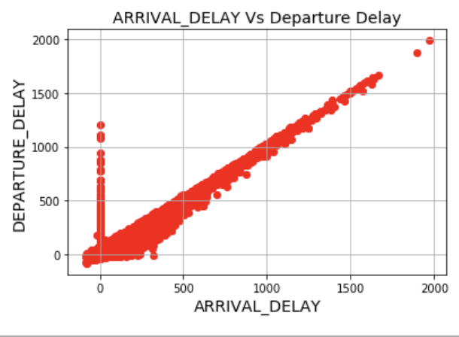
Arrival Delay and Wind Gust (Model 1)

Slide 16

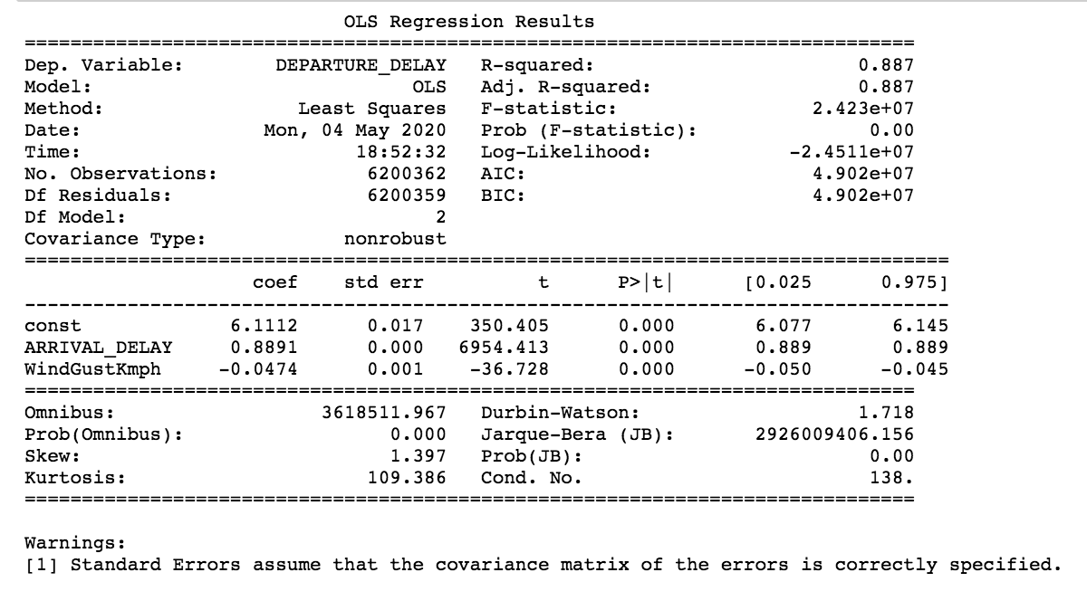
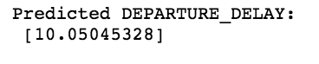
Arrival Delay and Wind Gust (Model 1)
Notes:
Has a great r square value. Std error is low which is good.

Slide 17
Example of implemented formula
Departure Delay (Y) = (Intercept) + (Arrival Delay coef)*X1 + (Windgust coef)*X2
X = arrival delay and windgust
Y = departure delay
Departure Delay = (6.1111745355551434) + (0.88908182 * 4.5 ) + (-0.04737649 * 1.3 )
Predicted departure delay: 10.0504533
Notes:
4.5 is average of arrival delay and 1.3 is average of the windgust.

Slide 18
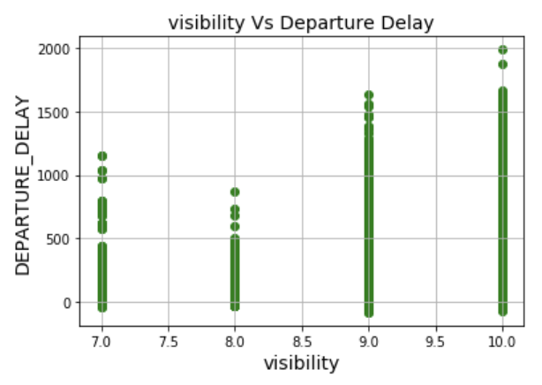
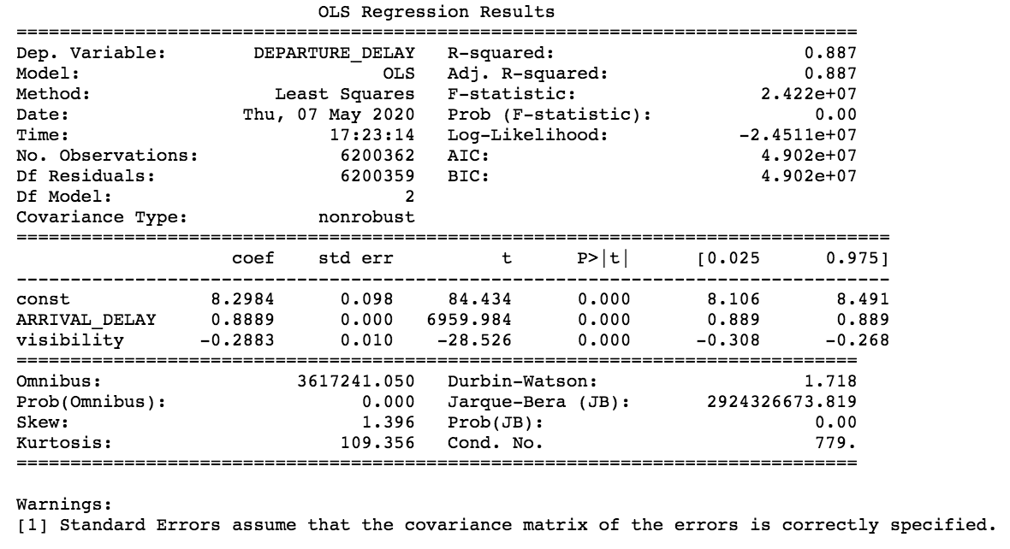
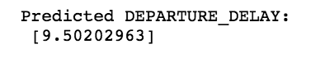
Arrival Delay and Visibility (Model 2)
Notes:
A clear linear relationship with visibility and departure delay. Has a good r-square value

Slide 19
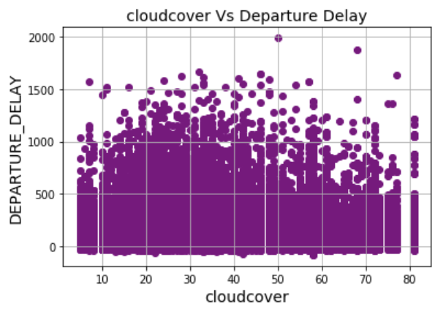
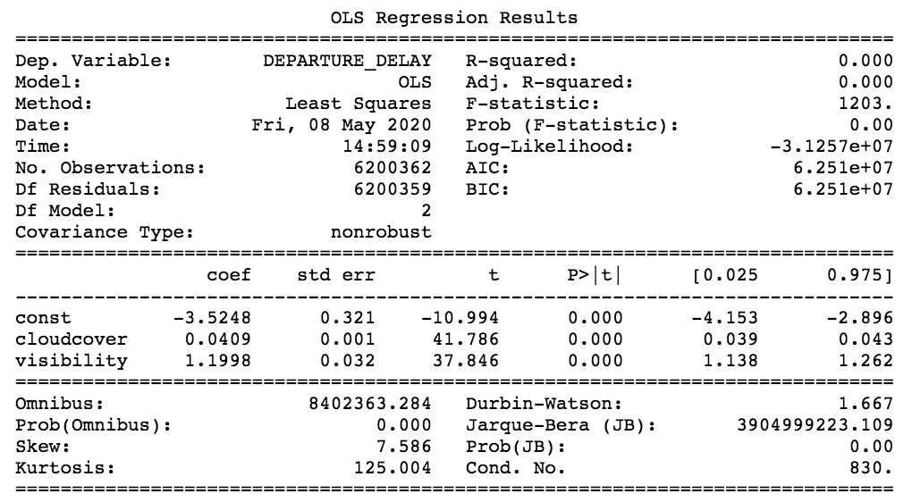
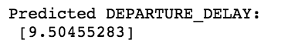
Cloud Cover & Visibility (Model 3)
Notes:
Really talk about the r-square of 0 here. Surprised by it. Because i saw this, i wanted to see how cloud cover and visibility together affected departure delay

Slide 20
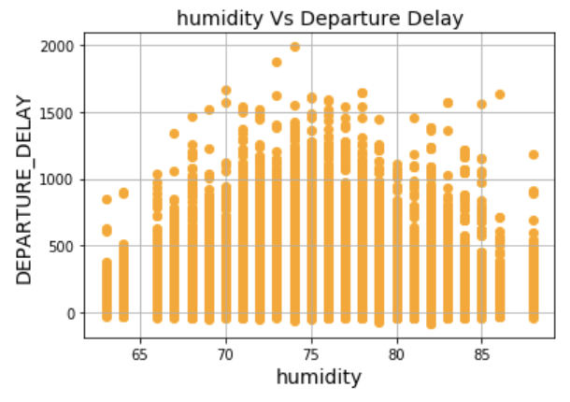
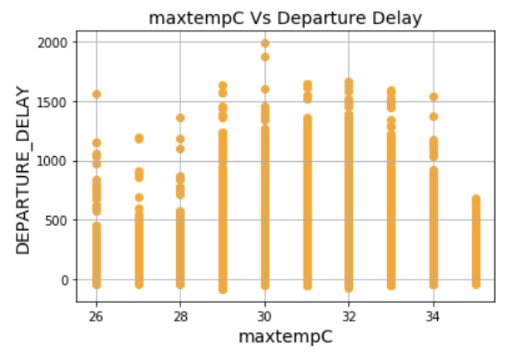
Max Temperature and Humidity (Model 4)
Notes:
One of my peers mentioned that they wanted to see the relation of min and max temp and humidity,... so here it is….maybe max temp and humidity

Slide 21
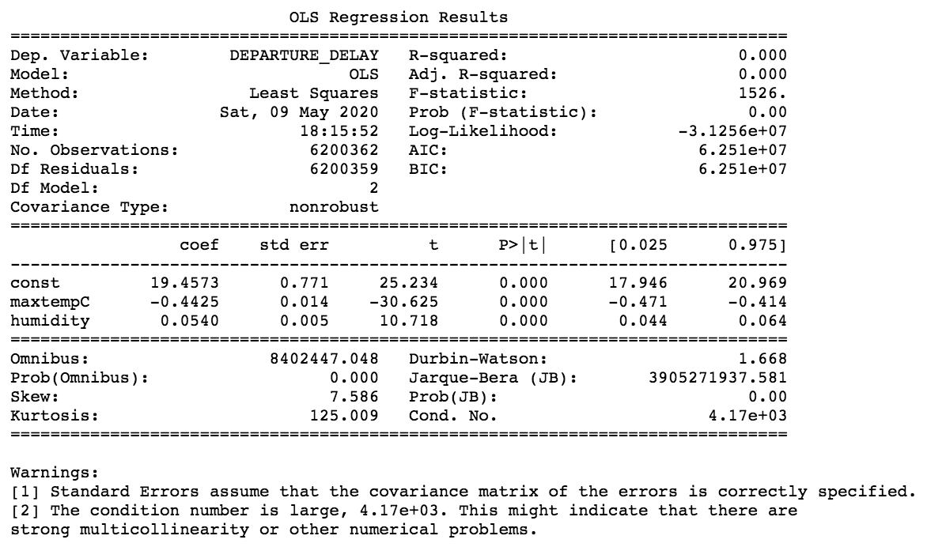
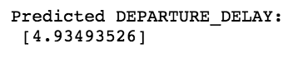
Max Temperature and Humidity (Model 4)

Slide 22
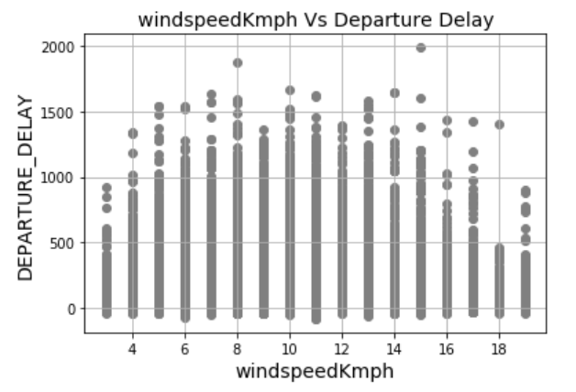
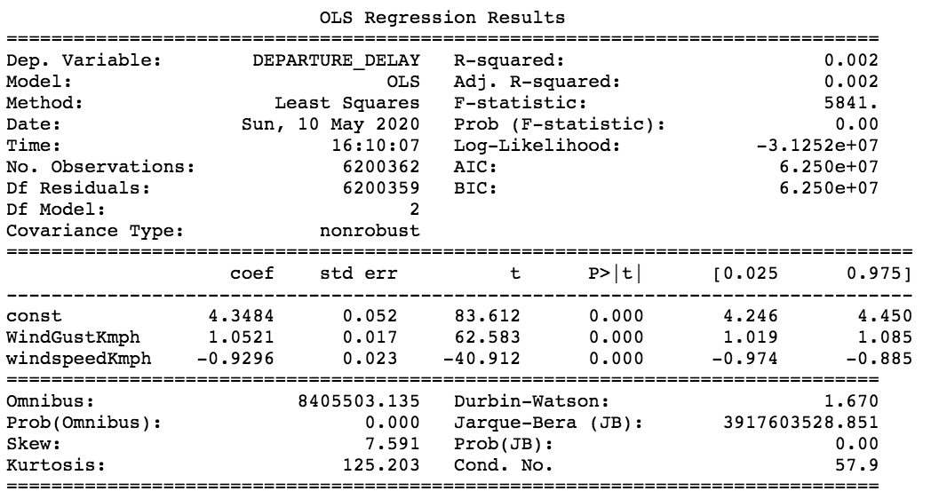
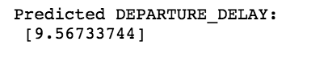
Wind-gust and Wind-speed (Model 5)
Notes:
All gusts are a type of wind. A gust is a sudden increase of the wind's speed that lasts no more than 20 seconds.

Slide 23
Results
Which model was the best?
Which features do i think most impact weather induced delays
etc.
Notes:
Model 1 and 2 were the best because they had the highest r-squared values and a low standard error. Both of these models include arrival delay which is most likley the reason for a higher accuracy. It seems that windgust and visibility play a large part in departure delays. The r squared value for models 1,2,3 are either very low or are zero. I am disappointed to see the lower r square values, but i plan to create better fitting models in the future.

Slide 24
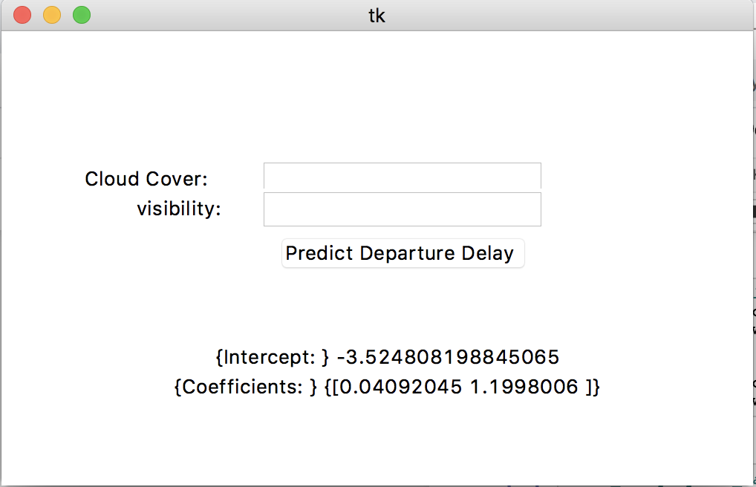
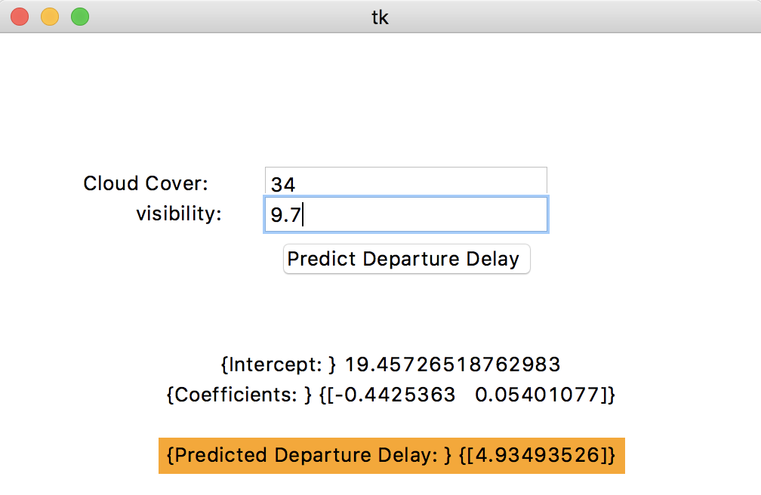
Graphical User Interface (GUI)
Notes:
After creating the various models, I realized I wanted to create a sample interface where a user can input data and see a predicted departure delay. In this particular image, the user can input Cloud Cover and Visibility

Slide 25
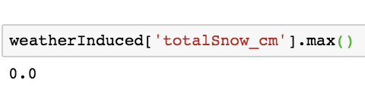
Setback
Notes:
Did not show me much, so i decided to see if there was any relation between total_snow_cm &.....cloud cover. Was a little dissapointed in this but i still wanted to see waht would happen to departure delay if i looked at total snow AND cloud cover….was excited to see the results but realized the max value of snow was 0. Did it not snow in 2015?

Slide 26
Future Goals
Improving current model
Implementing new algorithms
Play with Weather API more
Work with more data not just 2015 data
Play with GUI more
Notes:
ALlowing people to put in their flight info to predict a delay

Slide 27

Questions?
Please contact me via email: sjain3@umbc.edu
Notes:
I know this is the last project but any suggestions/feedback to better this project in the future would be appreciated.

Slide 28
Resources
https://www.kaggle.com/usdot/flight-delays#airlines.csv
https://arxiv.org/pdf/1903.06740.pdf
https://engineering.upside.com/applying-predictive-analytics-to-flight-delays-85413ca4939f

